Slide 1

DIGITAL ELECTRONICS
III Semester CSE
Dr. Ranjita Rout
DEPARTMENT OF ELECTRONICS AND COMMUNICATION ENGINEERING
SCHOOL OF ENGINEERING & TECHNOLOGY
GIET UNIVERSITY, GUNUPUR, ODISHA

Slide 2
Registers and Counters
Shift Registers;
Data Transmission in Shift Registers;
SISO, SIPO, PISO, and PIPO Shift Registers

Slide 3
Registers
A register is a group of flip‐flops, each one of which shares a common clock and is capable of storing one bit of information.
An n‐bit register consists of a group of n flip‐flops capable of storing n bits of binary information.

Slide 4
Shift Registers
A register capable of shifting the binary information held in each cell to its neighboring cell, in a selected direction, is called a shift register.
The logical configuration of a shift register consists of a chain of flip‐flops in cascade, with the output of one flip‐flop connected to the input of the next flip‐flop.
All flip‐flops receive common clock pulses, which activate the shift of data from one stage to the next.

Slide 5
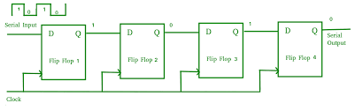

Slide 6
Data Transmission in Shift Registers
Data may be shifted into or out of the register either in serial form or in parallel form.
So there are four basic types of shift registers:
  Serial-in, Serial-out (SISO)
  Serial-in, Parallel-out (SIPO)
  Parallel-in, Serial-out (PISO)
  Parallel-in, Parallel-out (PIPO)
The process of data shifting in these registers is illustrated in Figure.

Slide 7
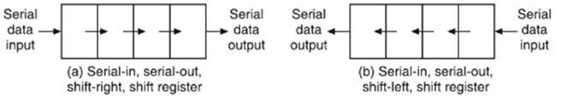

Slide 8
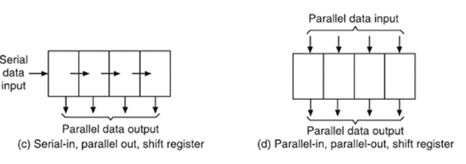
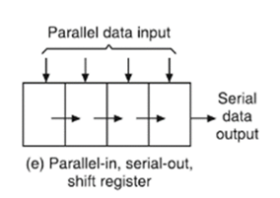

Slide 9
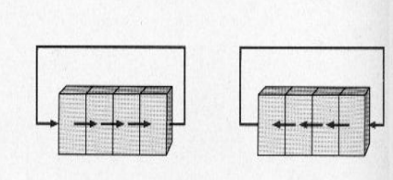
Shift register has two shift operations that are controlled by the signals SHR (Shift Right) and SHL (Shift Left).
In addition to the shift operations, a register may also have the capability of the rotate operations ROR (Rotate Right) and ROL (Rotate Left).
Rotate Right
Rotate Left

Slide 10
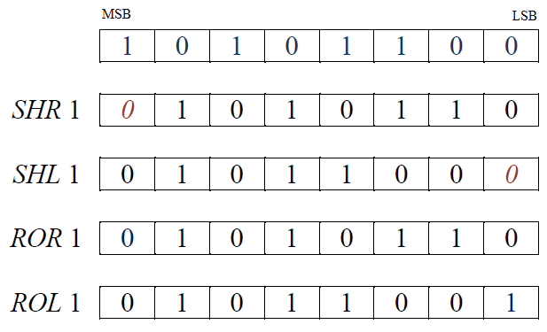

Slide 11

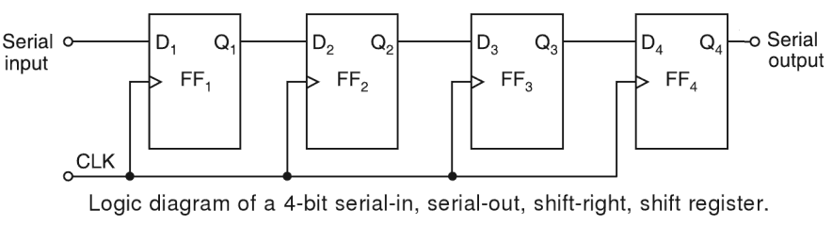
Serial-In Serial-Out (SISO) Shift Register
This type of shift register accepts data serially, i.e. one bit at a time, and also outputs data serially.
The logic diagram of a 4-bit serial-in, serial-out, shift-right, shift register using D FFs is shown in Figure.

Slide 12
With four stages, i.e. four FFs, the register can store up to four bits of data. Serial data is applied at the D input of the first FF. The Q output of the first FF is connected to the D input of the second FF, the Q output of the second FF is connected to the D input of the third FF, and the Q output of the third FF is connected to the D input of the fourth FF. The data is outputted from the Q terminal of the last FF.
When serial data is transferred into a register, each new bit is clocked into the first FF at the positive-edge of each clock pulse. The bit that was previously stored by the first FF is transferred to the second FF. The bit that was stored by the second FF is transferred to the third FF, and so on. The bit that was stored by the last FF is shifted out.

Slide 13
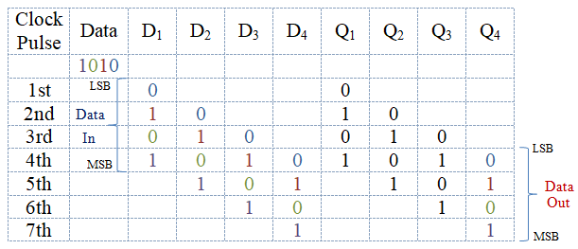
In n-bit serial-in serial-out (SISO) shift register n number of clock pulses are required to store the n-bit data but in (2n – 1)th clock pulse the n-bit data out from the shift register.

Slide 14
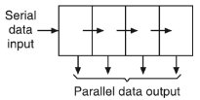
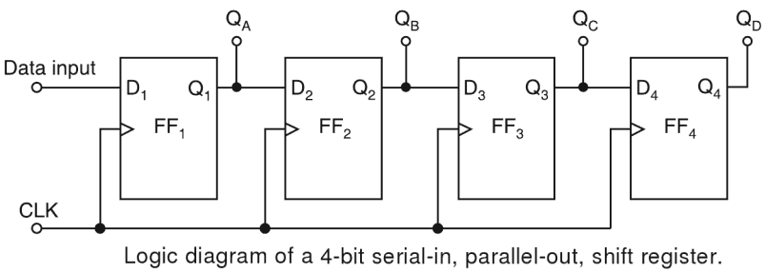
Serial-In Parallel-Out (SIPO) Shift Register
In this type of register, the data bits are entered into the register serially, but the data stored in the register is shifted out in parallel form.

Slide 15
Figure shows the logic diagram of a 4-bit serial-in, parallel-out, shift register using D FFs.
Once the data bits are stored, each bit appears on its respective output line and all bits are available simultaneously, rather than on a bit-by-bit basis as with the serial output.

Slide 16
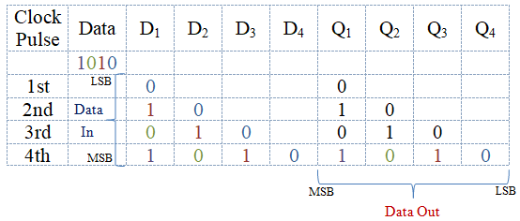
In n-bit serial-in parallel-out (SIPO) shift register n number of clock pulses are required to store the n-bit data but in nth clock pulse the n-bit data out from the shift register.

Slide 17
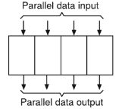
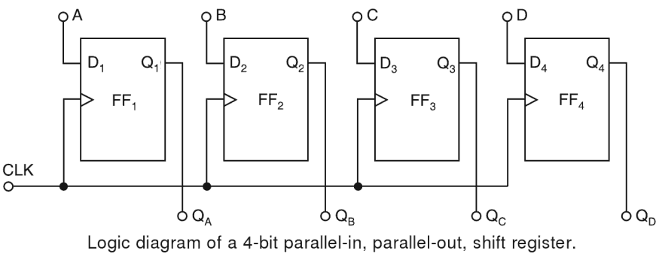
Parallel-In Parallel-Out (PIPO) Shift Register
In a parallel-in, parallel-out, shift register, the data is entered into the register in parallel form, and also the data is taken out of the register in parallel form.

Slide 18
Figure shows a 4-bit parallel-in, parallel-out, shift register using D FFs. Data is applied to the D input terminals of the FFs. When a clock pulse is applied, at the positive-edge of that pulse, the D inputs are shifted into Q outputs of the FFs. The register now stores the data. The stored data is available instantaneously for shifting out in parallel form.

Slide 19
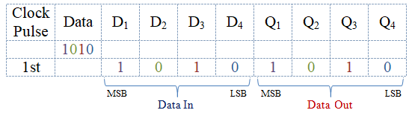
In n-bit parallel-in parallel-out (PIPO) shift register a single clock pulse is required to store the n-bit data but in same clock pulse the n-bit data out from the shift register.

Slide 20
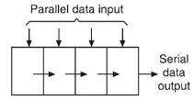
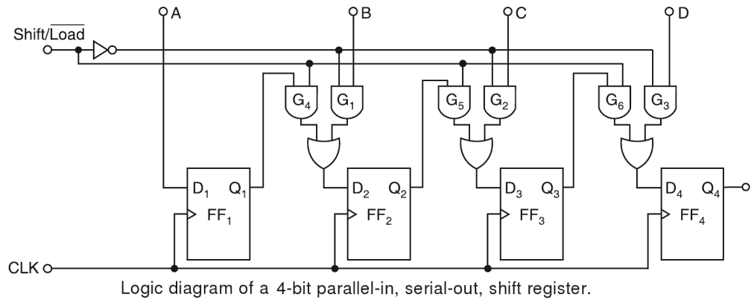
Parallel-In Serial-Out (PISO) Shift Register

Slide 21
For a parallel-in, serial-out, shift register, the data bits are entered simultaneously into their respective stages on parallel lines, rather than on a bit-by-bit basis on one line as with serial data inputs, but the data bits are transferred out of the register serially, i.e. on a bit-by-bit basis over a single line.
Figure illustrates a 4-bit parallel-in, serial-out, shift register using D FFs. There are four data lines A, B, C, and D through which the data is entered into the register in parallel form.

Slide 22
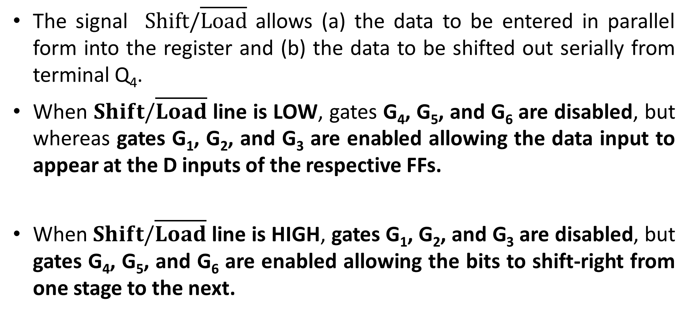
The signal $Shift/\overline{Load}$ allows (a) the data to be entered in parallel form into the register and (b) the data to be shifted out serially from terminal Q₄.
When $Shift/\overline{Load}$ line is LOW, gates G₄, G₅, and G₆ are disabled, but whereas gates G₁, G₂, and G₃ are enabled allowing the data input to appear at the D inputs of the respective FFs.
When $Shift/\overline{Load}$ line is HIGH, gates G₁, G₂, and G₃ are disabled, but gates G₄, G₅, and G₆ are enabled allowing the bits to shift-right from one stage to the next.

Slide 23
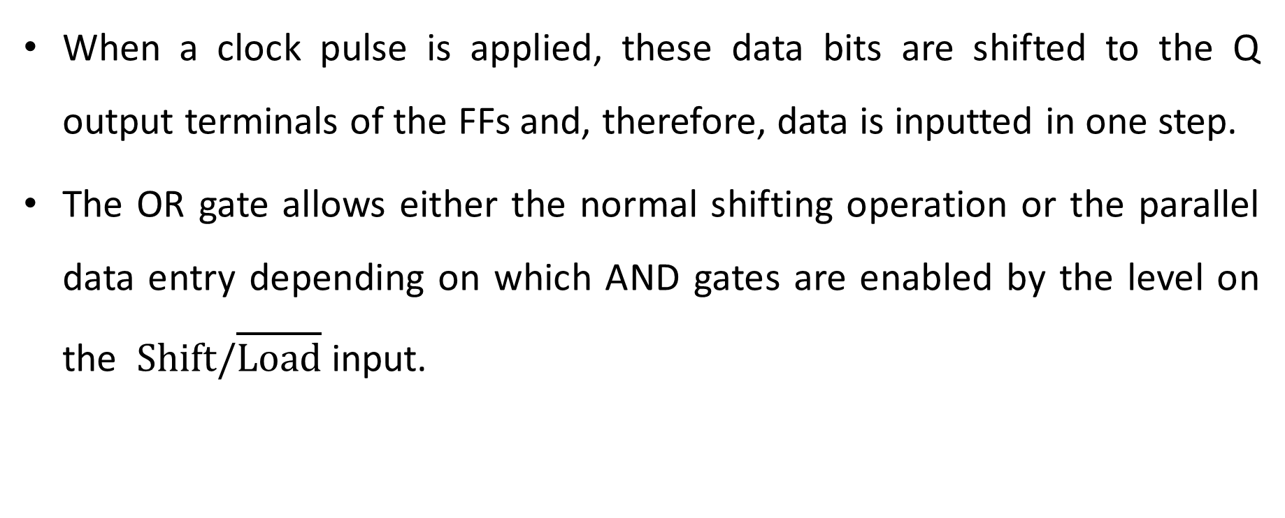
When a clock pulse is applied, these data bits are shifted to the Q output terminals of the FFs and, therefore, data is inputted in one step.
The OR gate allows either the normal shifting operation or the parallel data entry depending on which AND gates are enabled by the level on the $Shift/\overline{Load}$ input.

Slide 24
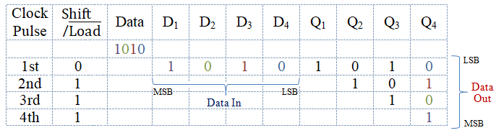
In n-bit parallel-in serial-out (PISO) shift register a single clock pulse is required to store the n-bit data but in nth clock pulse n-bit data out from the shift register.

